Slide 1

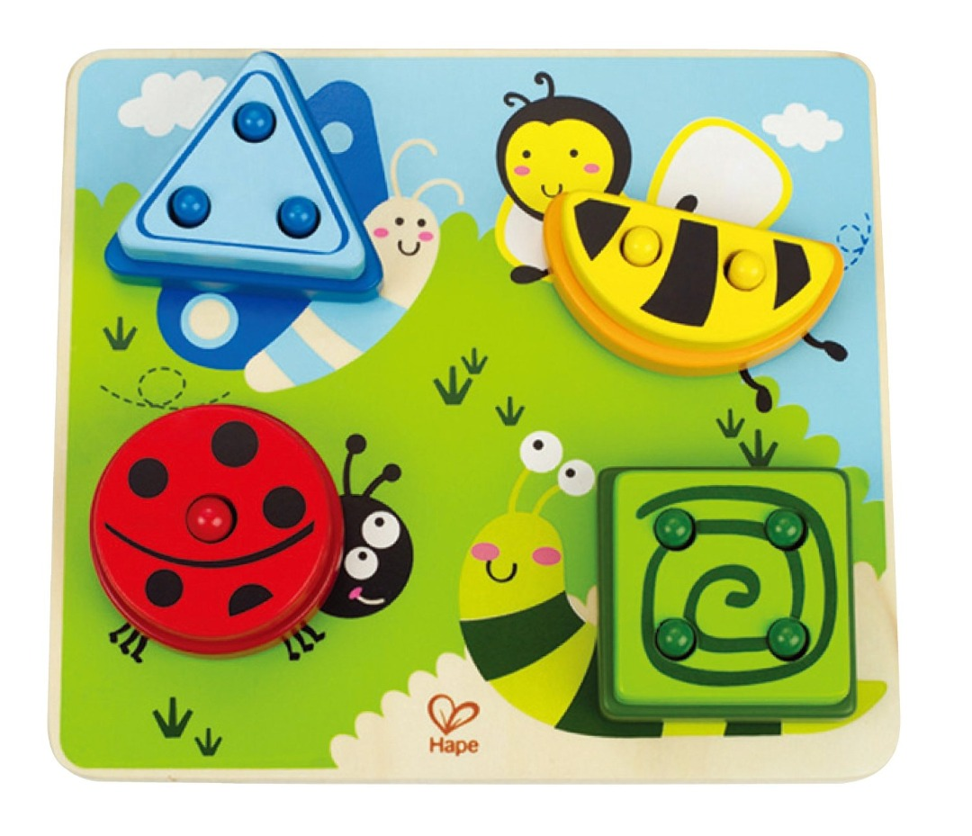
Build A Bug Sorter
Toy Name
Build A Bug Sorter
Manufacturer
HAPE
Age
12 – 24 months
Parts
1 Build A Bug Sorter Wooden Base
13 Multilayered Pieces
Develop Skills
Fine Motor
Cognitive
Imagination
How it Works
Susun bagian-bagian yang tersedia sesuai bentuk, warna, jumlah lubang untuk membentuk serangga yang ramah.
-
Sort the pieces by shape, color, number of holes, and stack them to build each friendly critter.
How To Clean
Simply clean using a cloth that has been sprayed with non-toxic anti bacterial solution
Warning
Store in a dry place
Keep out of direct sunlight

